Slide 1


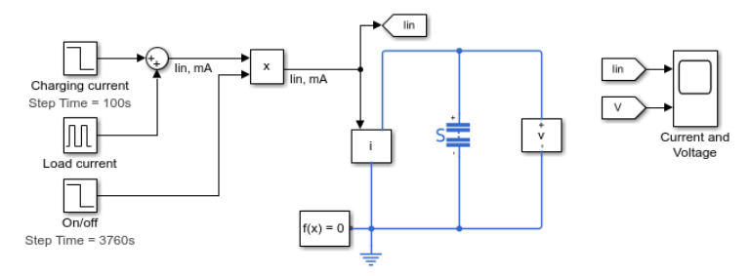
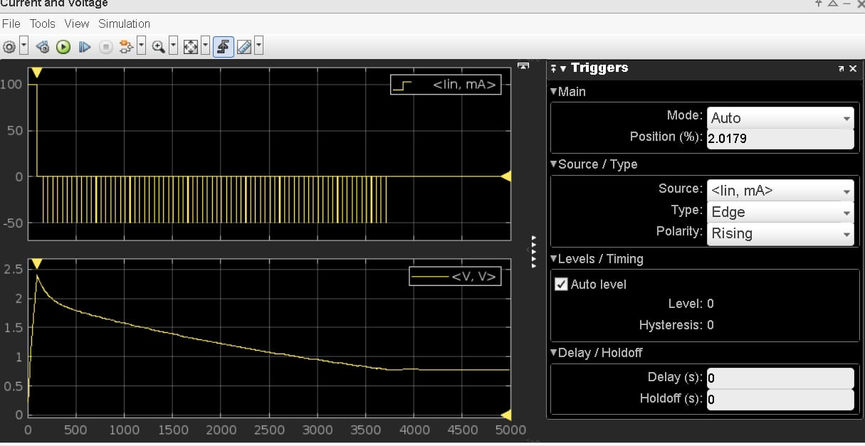
Supercapacitor Charging and Discharging Behavior
1oomA for 1oosec
Model 1
5omA for 1sec
Every 50 sec
For 1 hour

Slide 2
Supercapacitor Charging and Discharging Behavior
output1

Slide 3
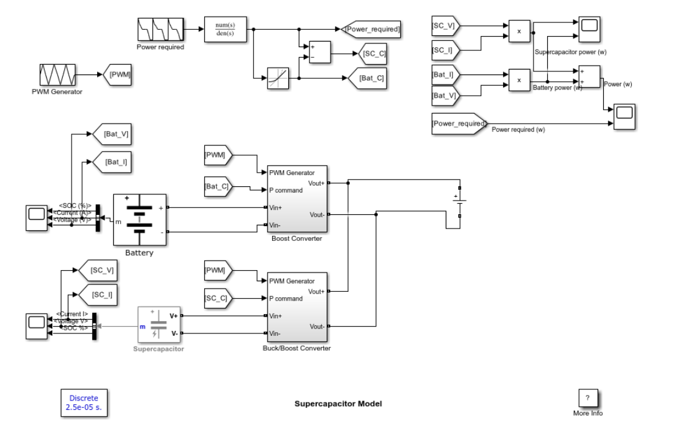
Supercapacitor Charging and Discharging Behavior
Model 2

Slide 4
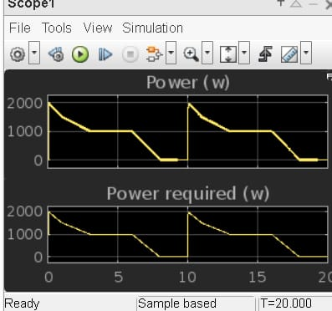
Supercapacitor Charging and Discharging Behavior
output2

